Slide 1

CRM for BMW
By
Group 8
Mr. Pongraphe Kangsanarak
Ms. Simon Tanquerido Pricilla Faye
Mr. Issaret Prachitmutita
Mr. Nguyen Thai Anh
Mr. Abhinav Asheesh Lugun

Slide 2
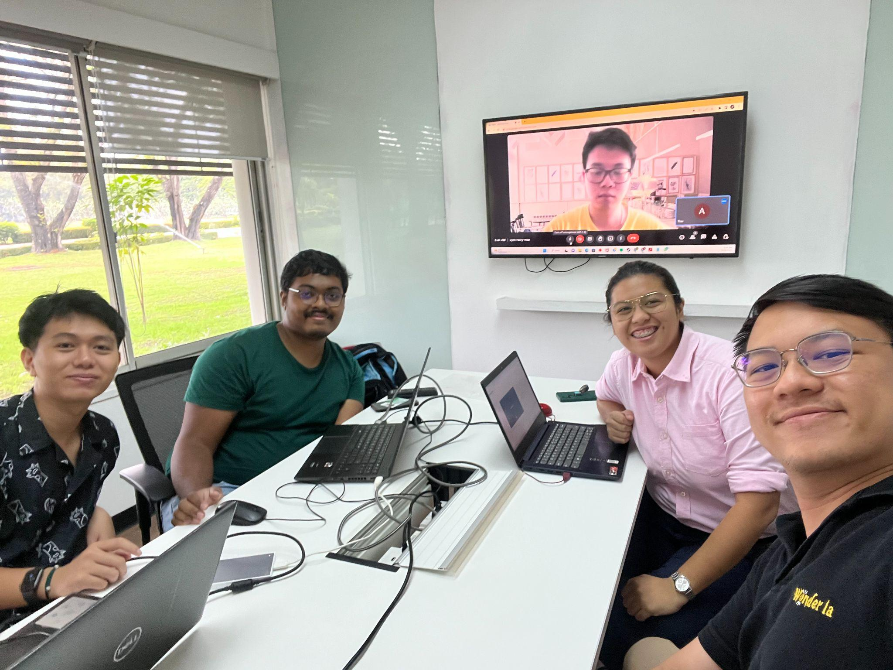

Slide 3
Outline
Project Description (recap)
Design of Graph Model
Total Nodes in Neo4j Database
Sample Nodes
Scenarios
Camparision of Different Technologies
Conclusion

Slide 4
Project description (recap)
Our goal in creating a customer relationship management system (CRM) for the BMW showroom is to digitally transform the business by concentrating on the two areas of management, and maintenance. Such as
Dashboard for executive
Sale statistics
Purchase and repair history
Repair Performance
Management system for maintenance team.
Accident History
Repair History
Spair parts inventory
Mechanic Team
Customer History
Purchase Order Transaction
Vehicle History
Warranty tracking

Slide 5
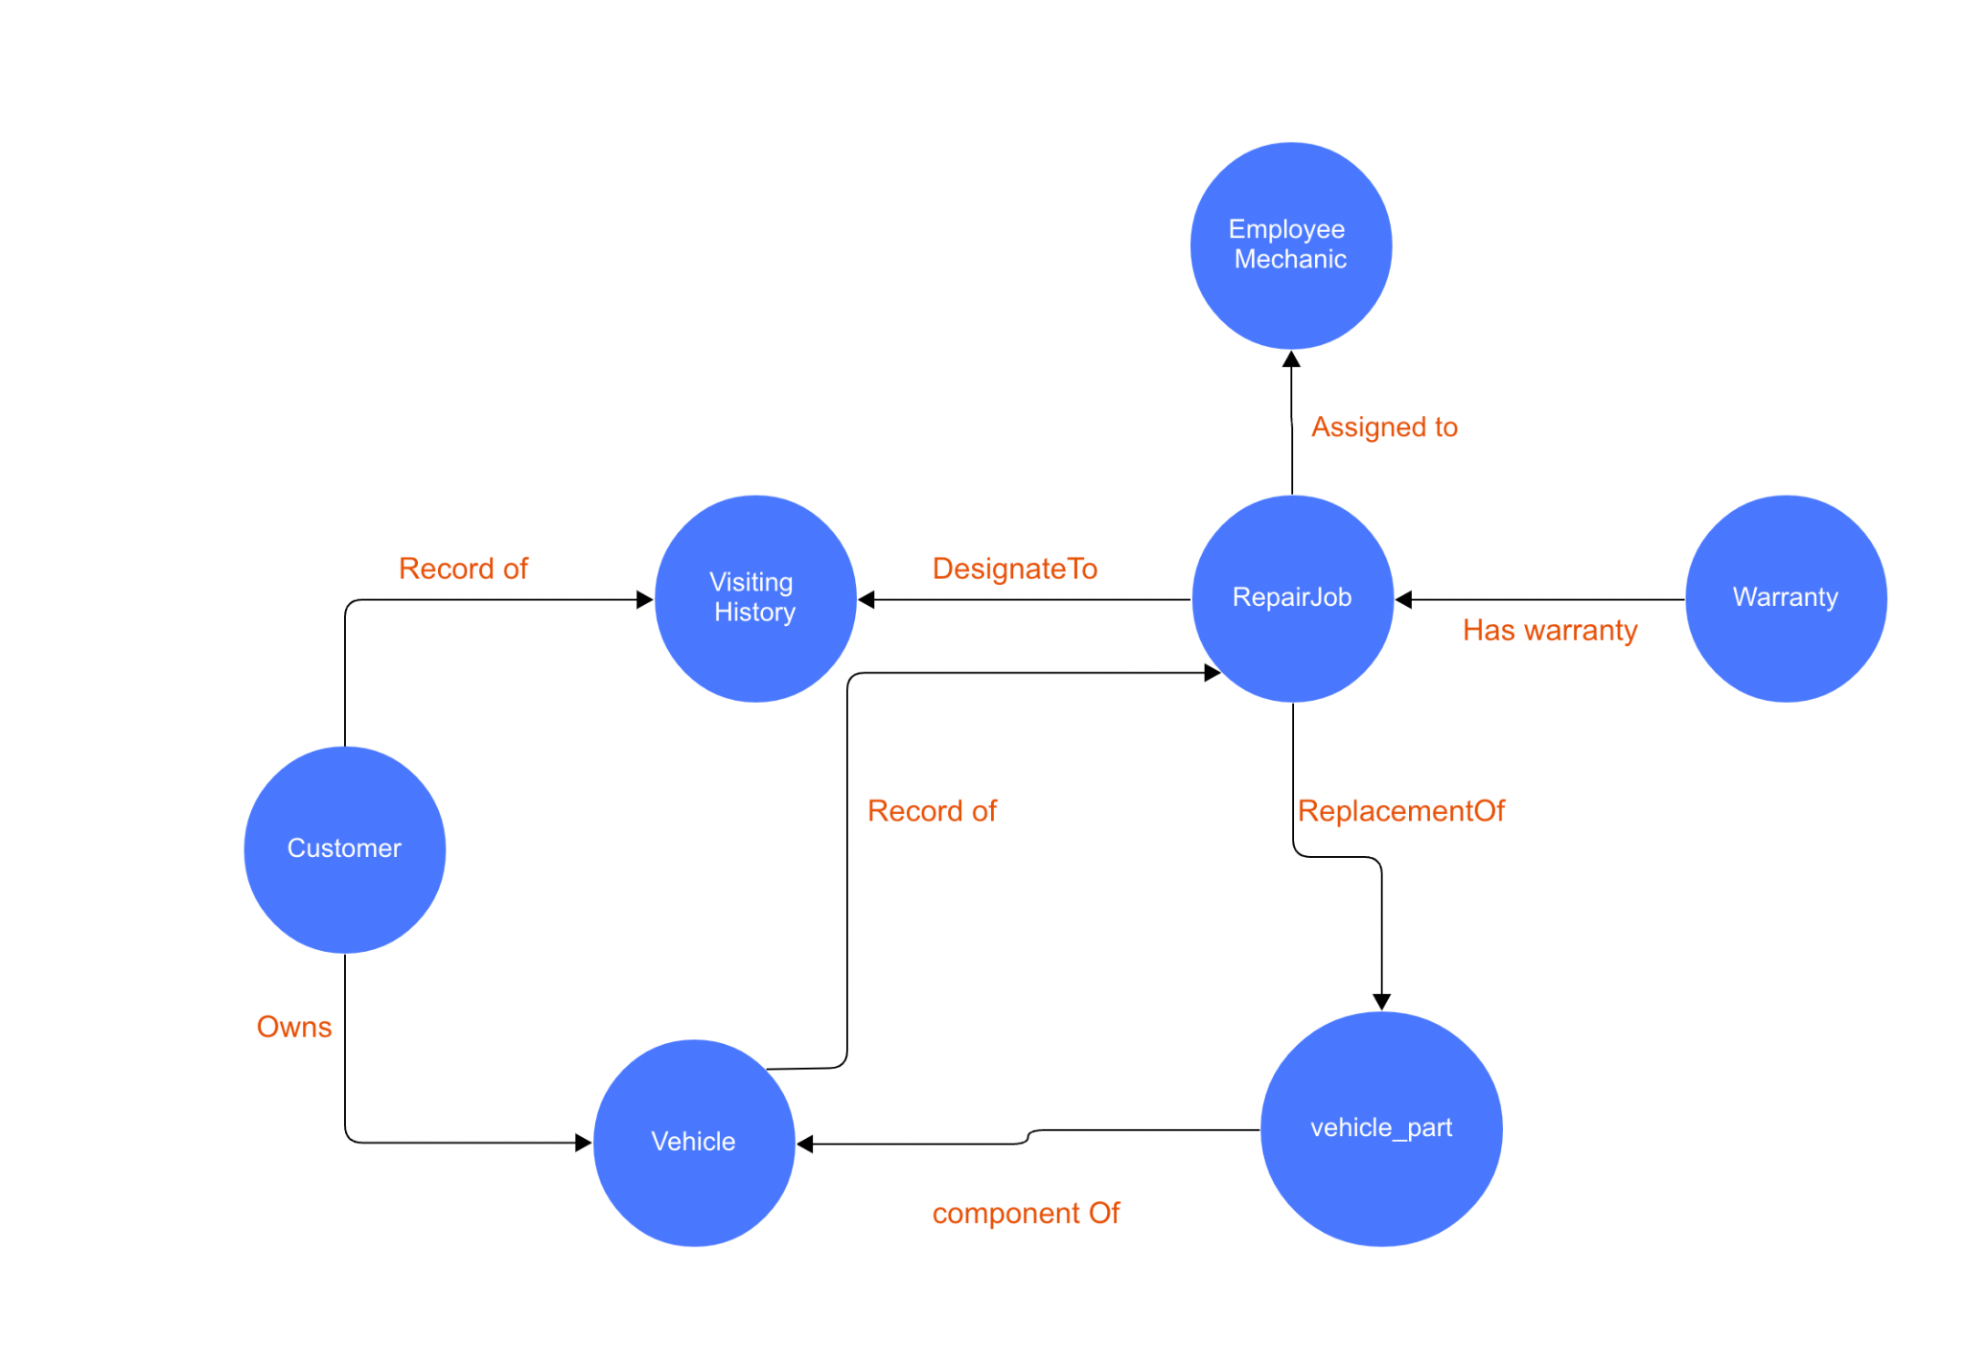
Design of Graph Model

Slide 6
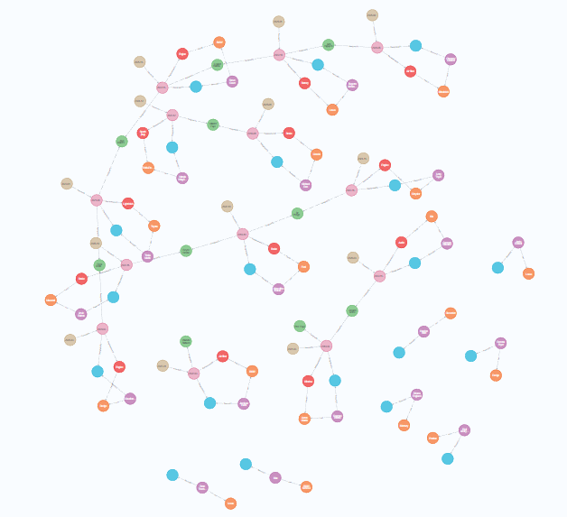
Total Nodes in Neo4j Database

Slide 7
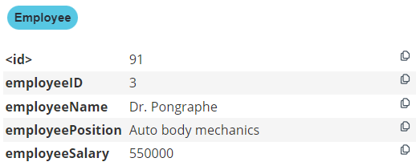
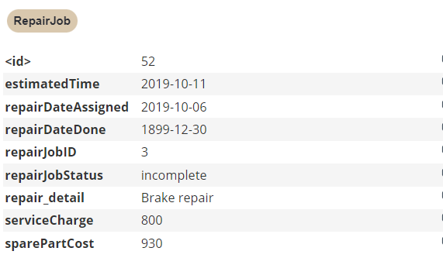
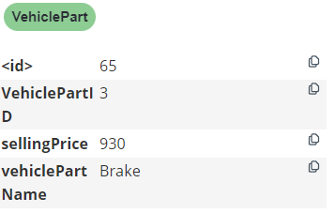
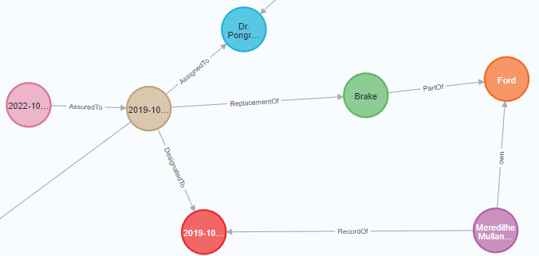
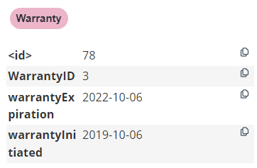
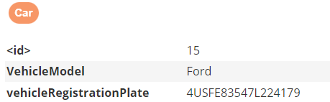
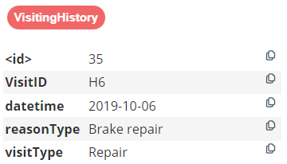
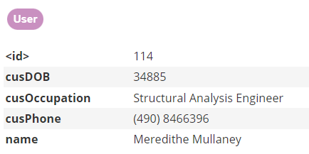
Sample Nodes

Slide 8
Scenarios:

Slide 9
Issaret: Select to find which car that is have more than 2 repair jobs for repair the same details within 1 month?

Slide 10
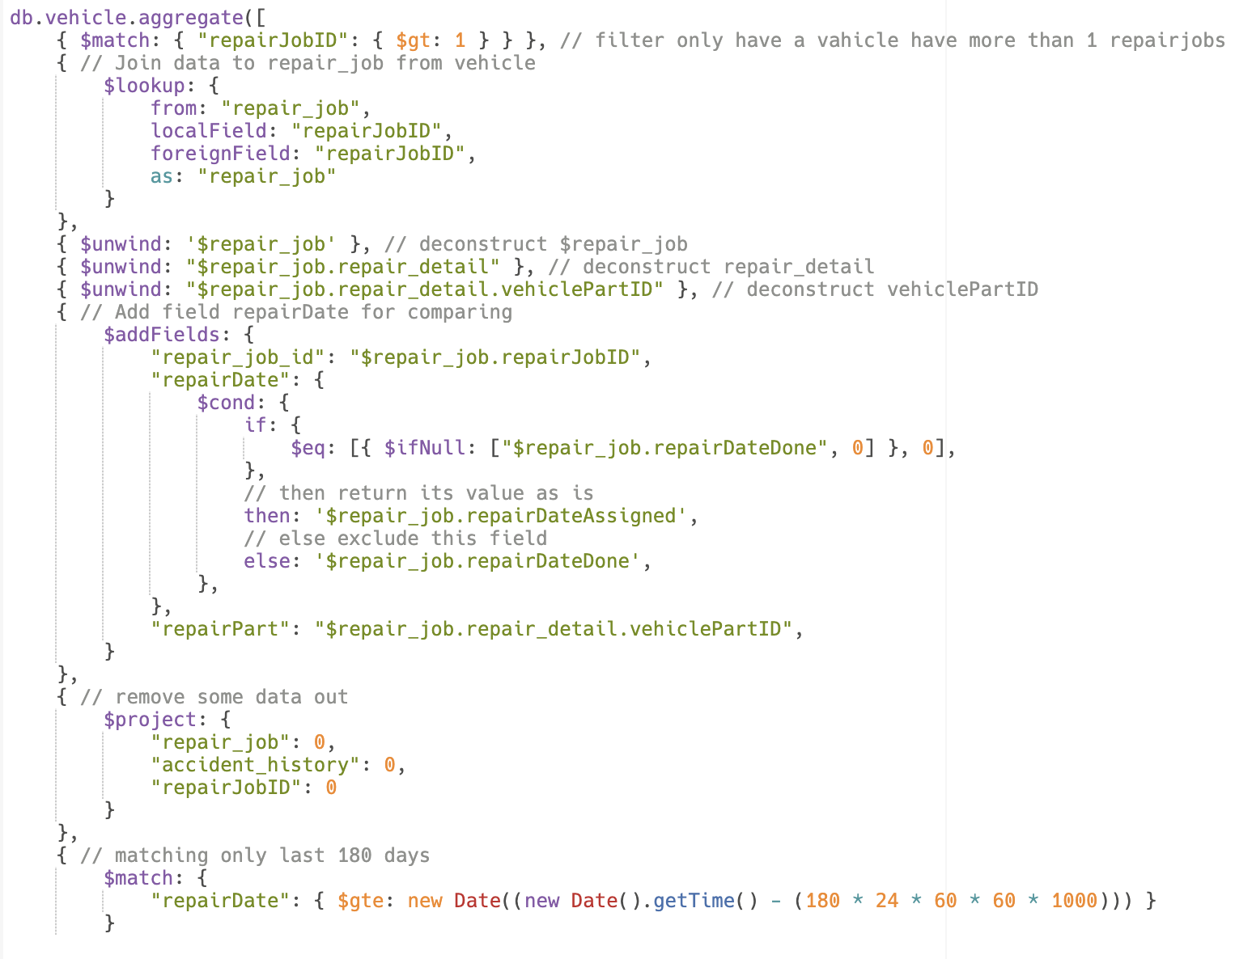
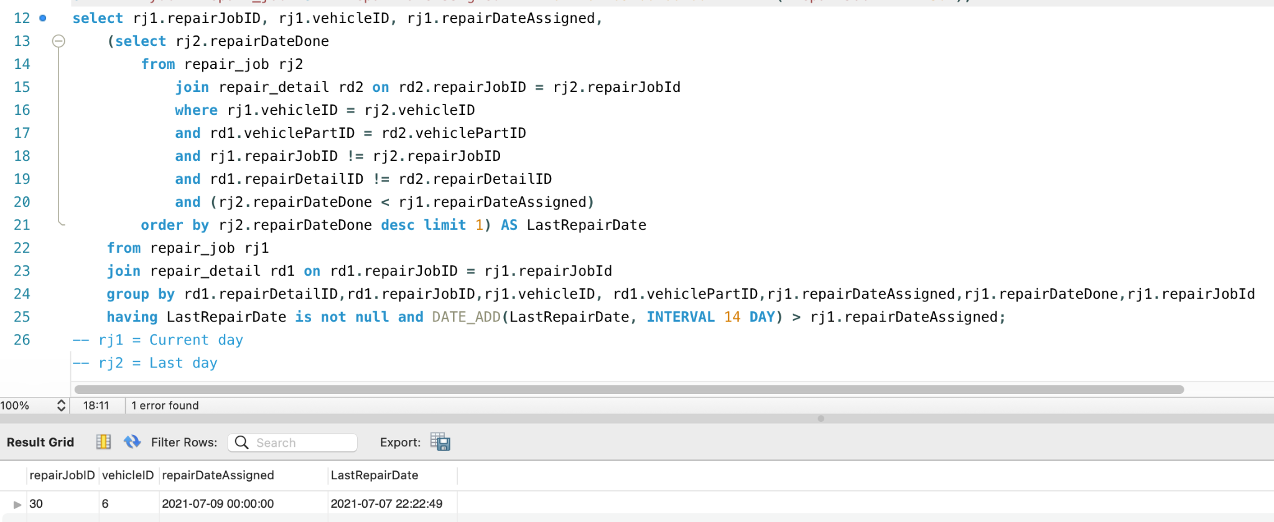
Issaret: Relational vs Document Database
Relational Database
Document Database

Slide 11
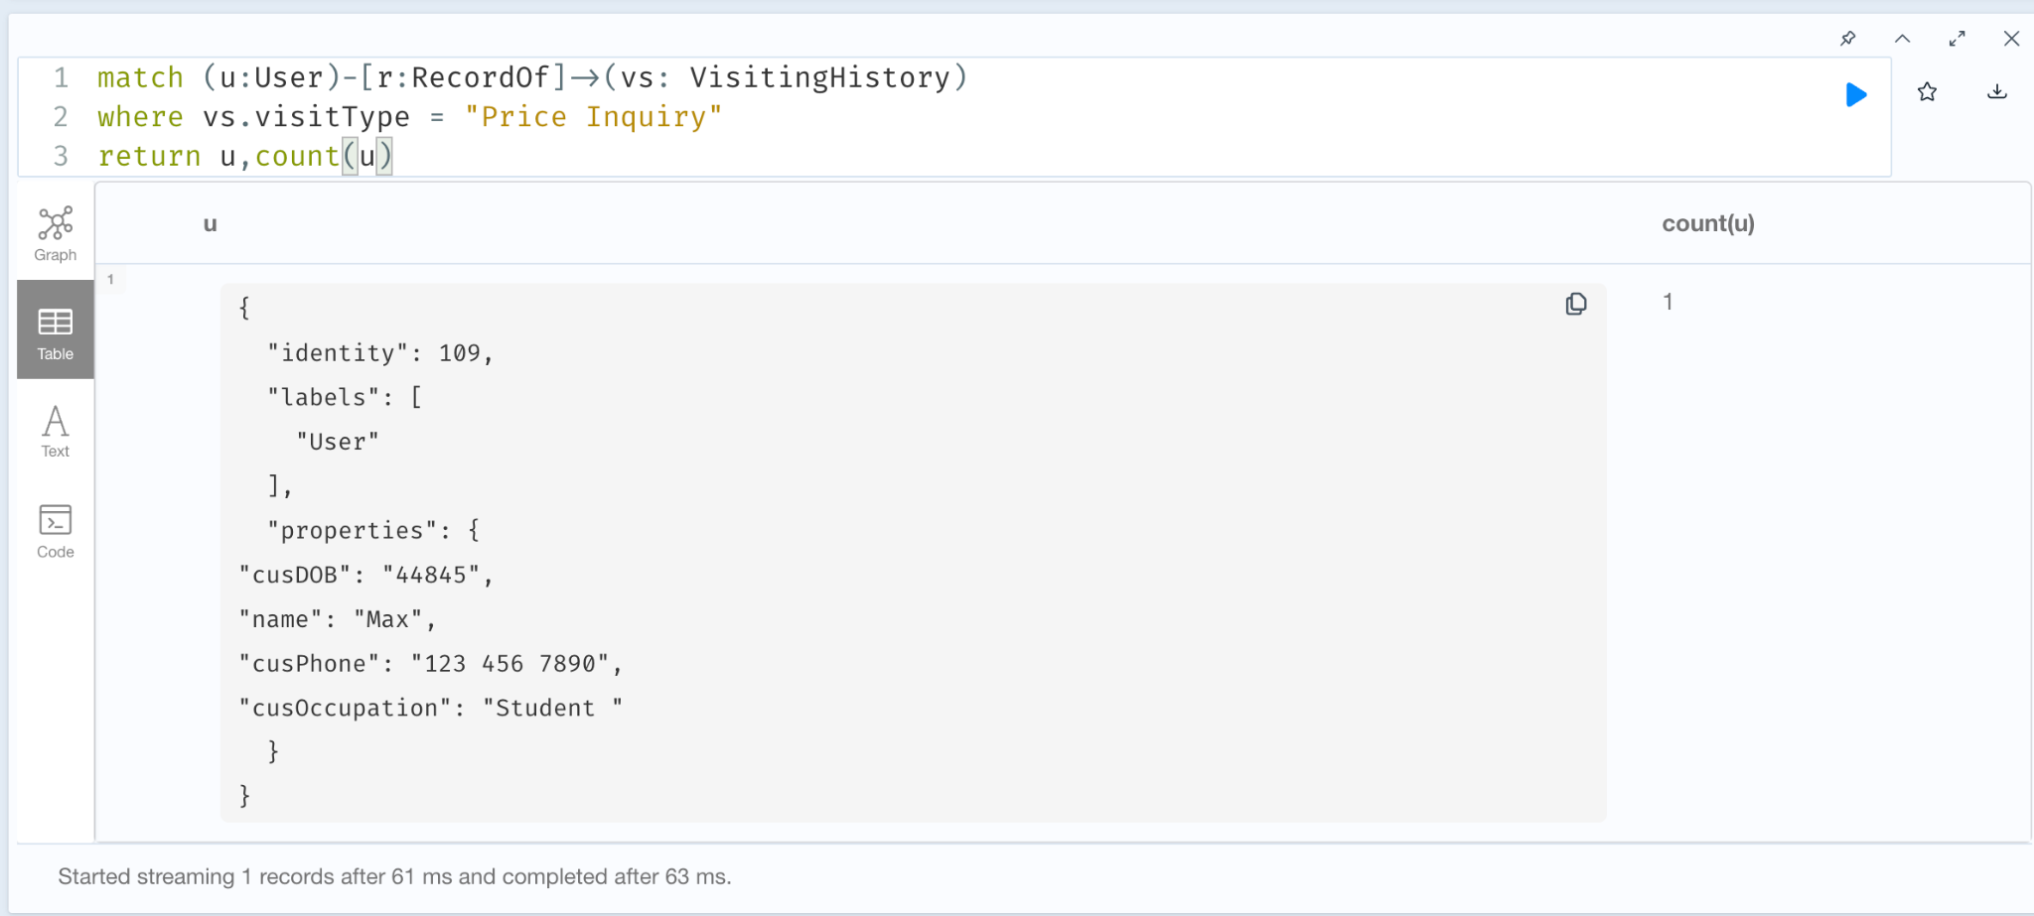
The manager would like to know how many client came to the shop and not repair?

Slide 12
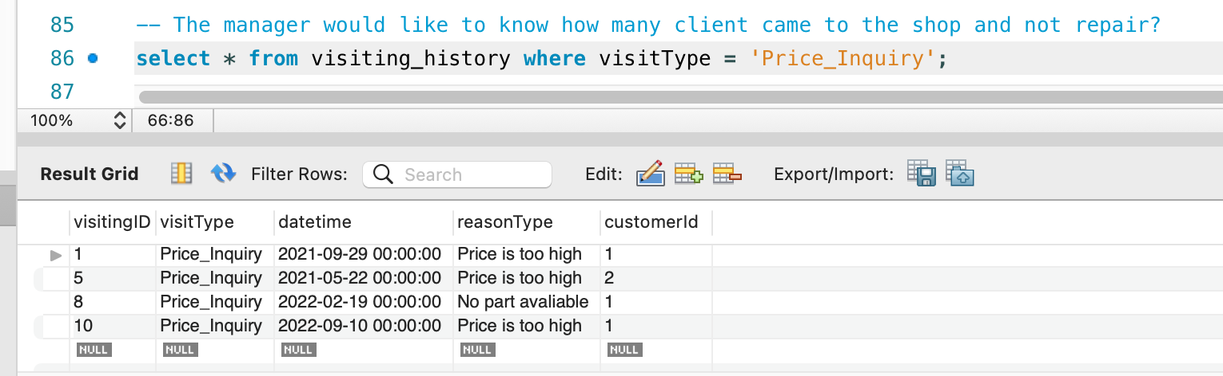
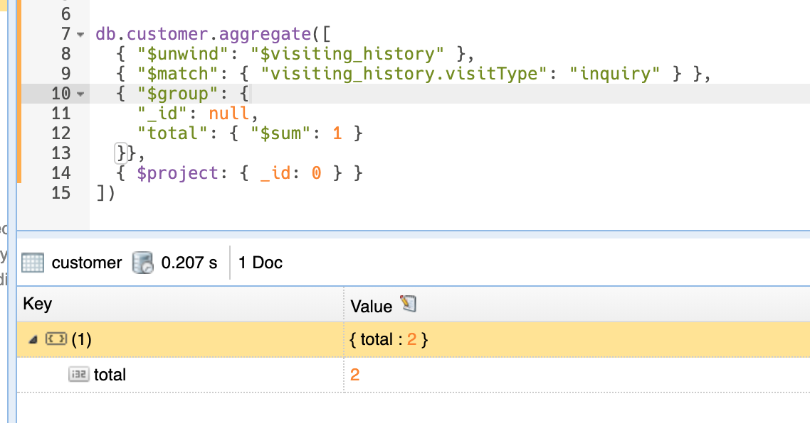
Relational Database
Document Database

Slide 13
AOF
Scenario:Manager want to know the customer and create a new one
Background: A new customer wants to register with the shop
Addressed question:
1. Check the the customer, old or new, using full name and insert their infor eg. visites and customer’s info .
2. Customer information relate car

Slide 14
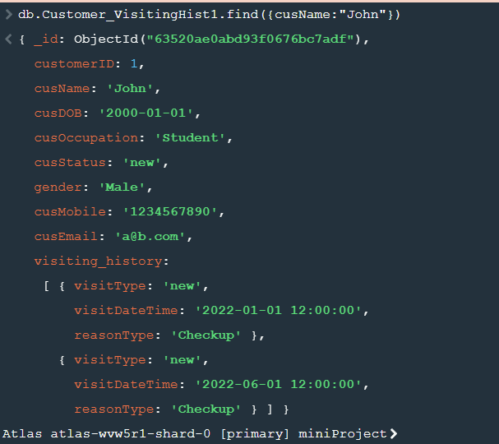
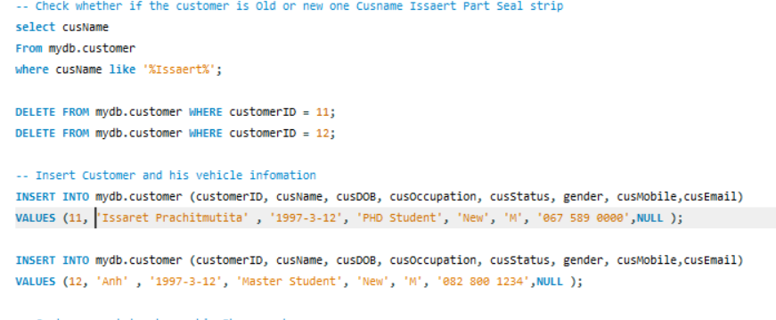
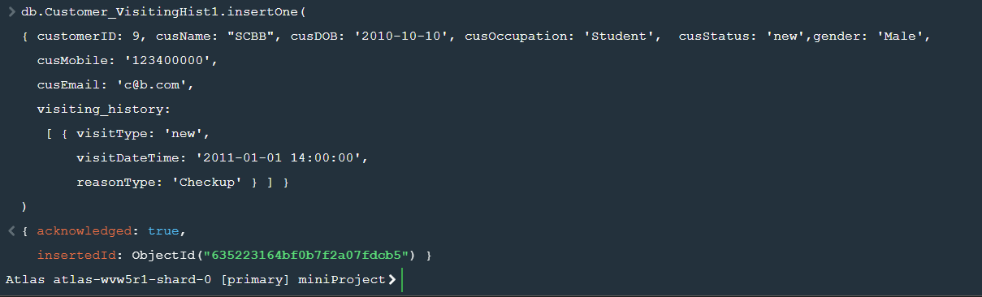
Aof
Relationship Model Document Model

Slide 15
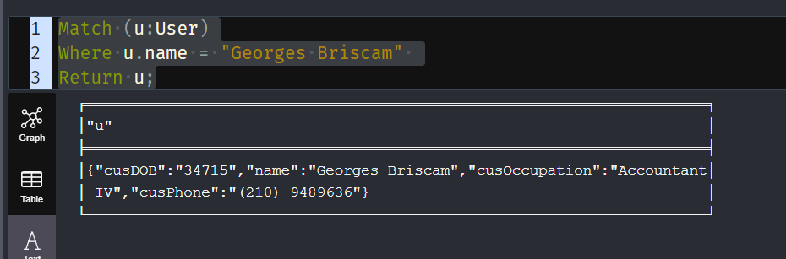
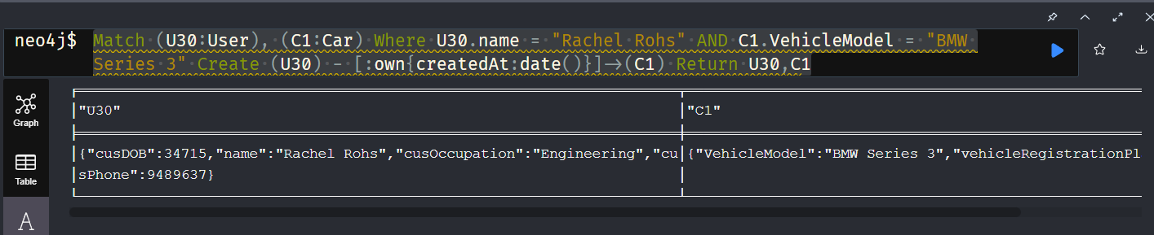
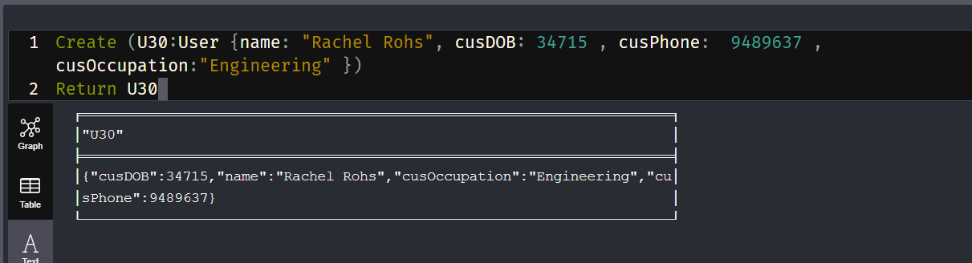
Aof
Graph Model
Match (U30:User), (C1:Car)
Where U30.name = "Rachel Rohs" AND C1.VehicleModel = "BMW Series 3"
Create (U30) - [:own{createdAt:date()}]->(C1) Return U30,C1
Match (u:User)
Where u.name = "Georges Briscam"
Return u;
Create (U30:User {name: "Rachel Rohs", cusDOB: 34715 , cusPhone: 9489637 , cusOccupation:"Engineering" })
Return U30

Slide 16
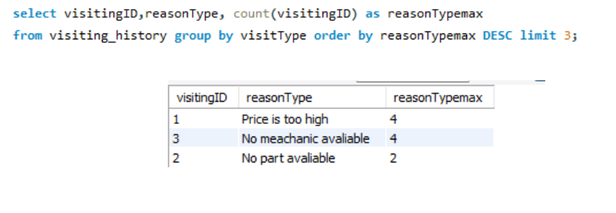
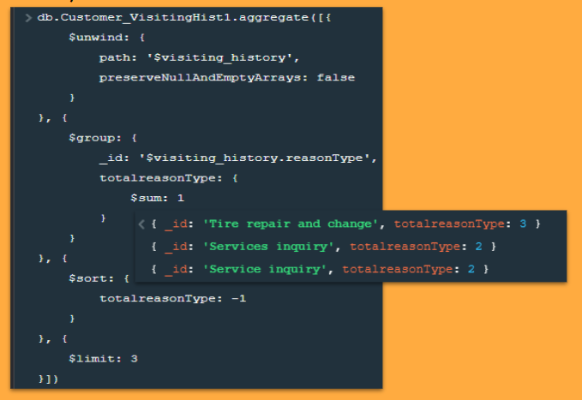
Anh
Part 1: The procurement team would like to know top 3 what is the most common services availed by the customers. This information will help them know what equipment and materials to buy for the next fiscal year.
Relationship Model Document Model

Slide 17
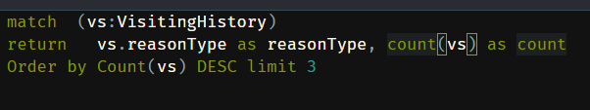
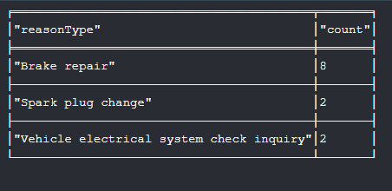
Anh
Part 1: The procurement team would like to know top 3 what is the most common services availed by the customers. This information will help them know what equipment and materials to buy for the next fiscal year.
Graph Model Result

Slide 18
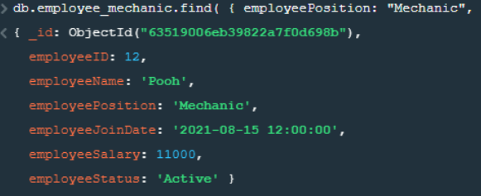
Anh
Part 2: Assuming the country suffers from high inflation, the basic salary of the society is 500000 baht, so the manager wants to find people whose salary is below 500000 to raise them above the basic salary.
Document Model

Slide 19
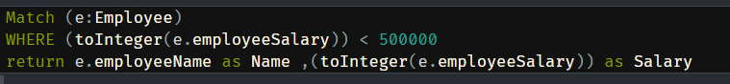
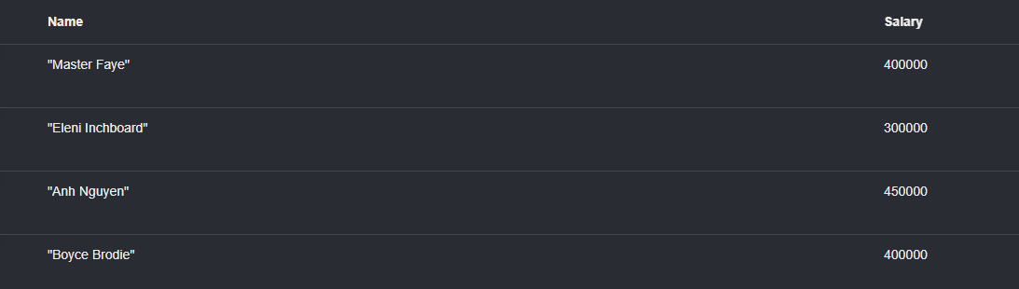
Anh
Part 2: Assuming the country suffers from high inflation, the basic salary of the society is 500000 baht, so the manager wants to find people whose salary is below 500000 to raise them above the basic salary.
Graph Model Result

Slide 20
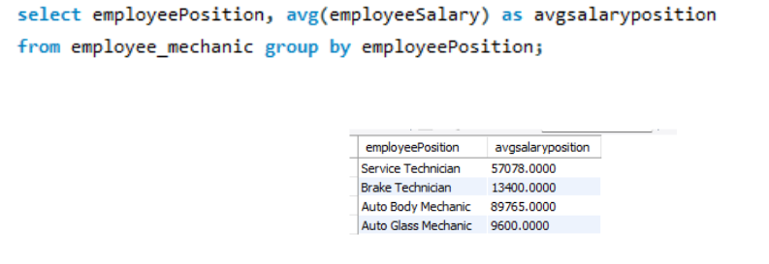
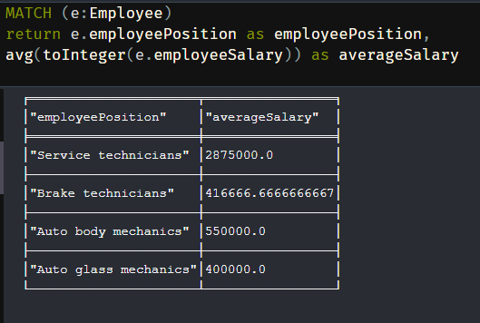
Anh
Part 3: Calculate average salary for each position. Recruiters will base on the average salary of each position to give a salary when recruiting.
Relationship Model Graph Model

Slide 21
Abhinav
Scenario: Ordering Vehicle Parts
Description:
As the manager, I would like to know which vehicle parts to order more based on current repair demand
Questions to answer:
Which repair problems are most common?
Which vehicle spare parts are most used?

Slide 22
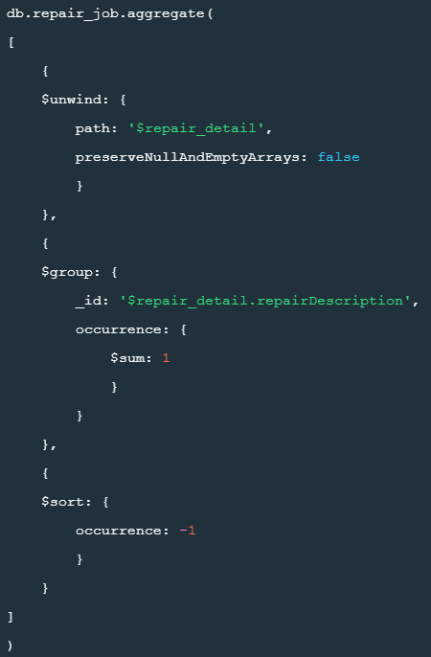
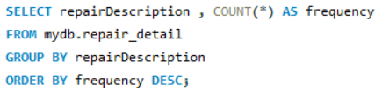

Abhinav
Part 1: Which repair problems are most common?
Relationship Model Document Model

Slide 23
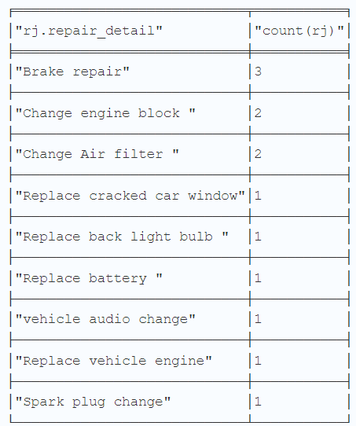
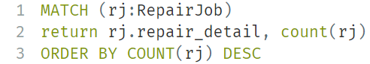
Abhinav
Part 1: Which repair problems are most common?
Graph Model Result

Slide 24
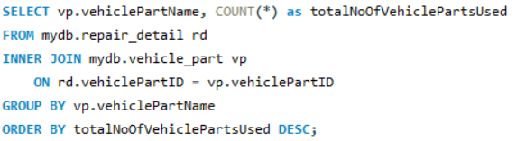
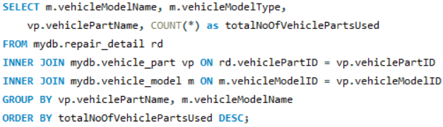
Abhinav
Part 2: Which vehicle spare parts are most used?
Relationship Model
By total vehicle part: By vehicle Model:

Slide 25
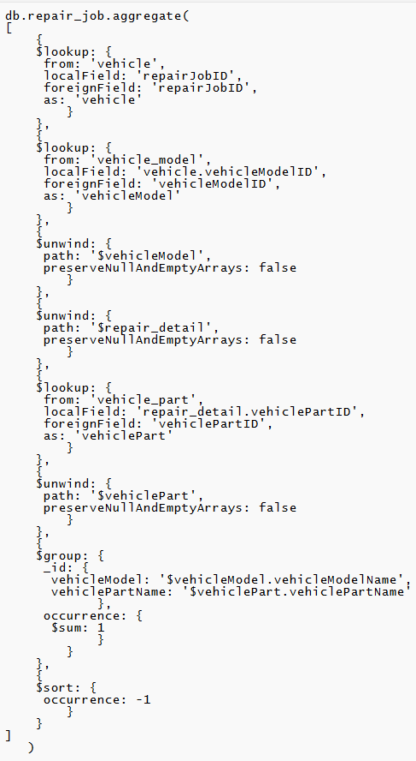
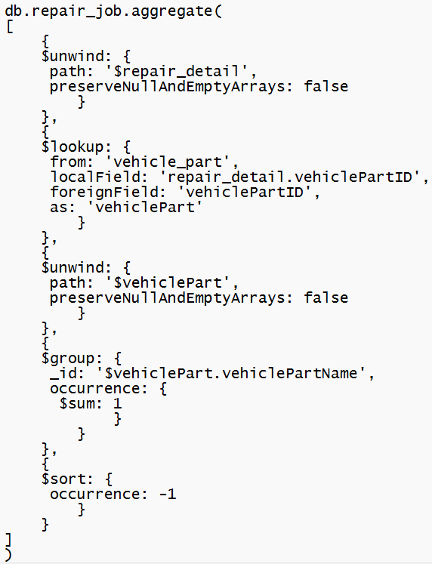
Abhinav
Part 2: Which vehicle spare parts are most used?
By vehicle Model:
Document Model
By total vehicle part:

Slide 26
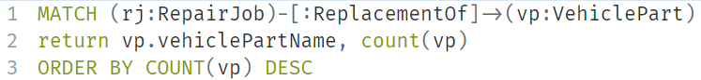
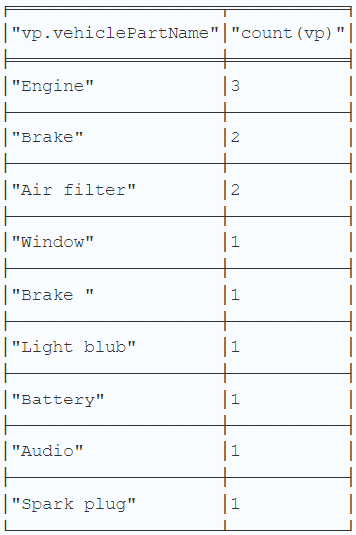
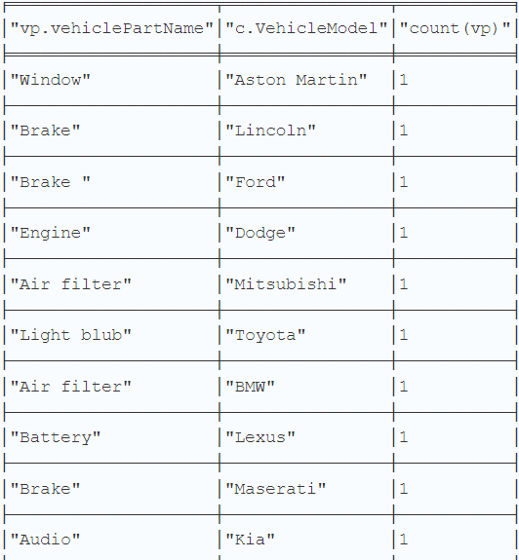
Abhinav
Part 2: Which vehicle spare parts are most used?
Graph Model
By total vehicle part: By vehicle Model:

Slide 27
Abhinav
Scenario Conclusion:
Order engine, brakes, and air filters more

Slide 28
Faye
What is the most common repair done to cars?
Relationship Model
select repairDescription, count(repairDescription) as Frequency_of_Repair
from repair_detail
group by repairDescription
order by Frequency_of_Repair desc
limit 2 ;
Graphical Model
match (n:RepairJob)
where exists (n.repair_detail)
return n.repair_detail, count(n.repair_detail)
order by count(n.repair_detail) desc
limit 2

Slide 29
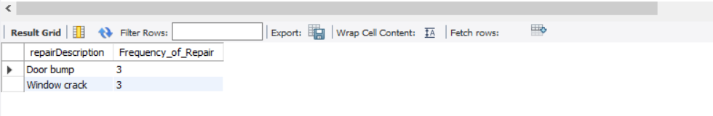
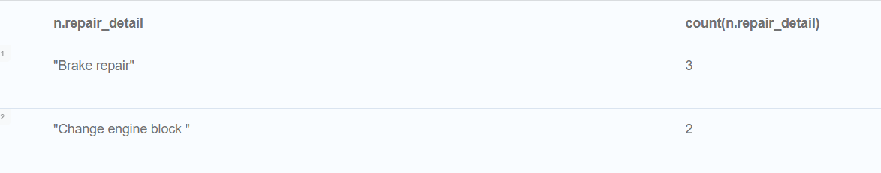
Faye
What is the most common repair done to cars?
Relationship Model
Graphical Model

Slide 30
Faye
What part is the most commonly changed?
Relationship Model
select rd.vehiclePartId, vp.vehiclePartName name, count(rd.vehiclePartID)
as Frequency_Requested, vp.sellingPrice
from vehicle_part vp inner join repair_detail rd
on vp.vehiclePartID = rd.vehiclePartID
group by rd.vehiclePartID
order by Frequency_Requested desc;
Graphical Model
MATCH (n:RepairJob)-[r:ReplacementOf]->(vp:VehiclePart)
RETURN vp.vehiclePartName,
COUNT(r), vp.sellingPrice
order by COUNT(r)
desc

Slide 31
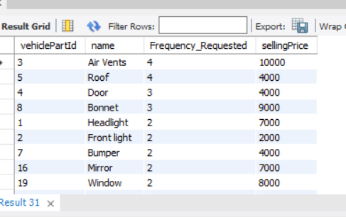
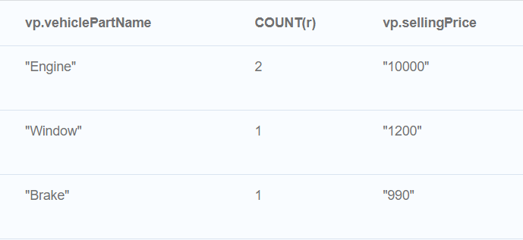
Faye
What part is the most commonly changed?
Relationship Model
Graphical Model

Slide 32
Faye
The procurement team would like to know how often does the different brand of cars visit the shop?
Document Model
db.vehicle_model.aggregate([
{
$project: {
_id:"$vehicleModelName" ,
numberOfVisits: { $cond: { if: { $isArray: "$vehicle_part" },
then: { $size: "$vehicle_part" },
else: "NA"} }
}
}
] )
Graphical Model
MATCH (v:Car)<-[o:own]-(u:User)-[r:RecordOf]->(vh:VisitingHistory)
RETURN v.VehicleModel,
COUNT(vh.visitType)
order by COUNT(vh.visitType)
desc

Slide 33
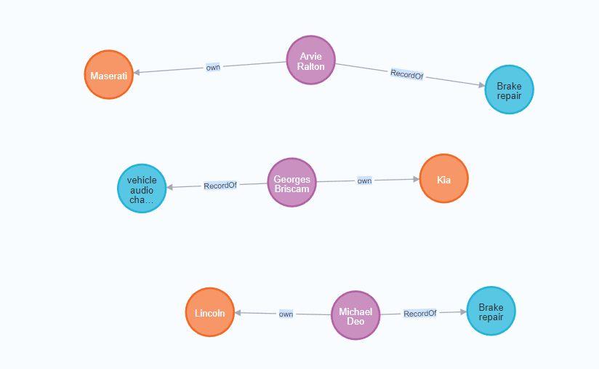
Faye
The procurement team would like to know how often does the different brand of cars visit the shop?
Graphical Model

Slide 34
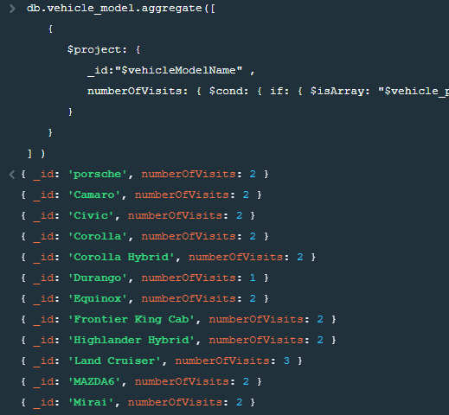
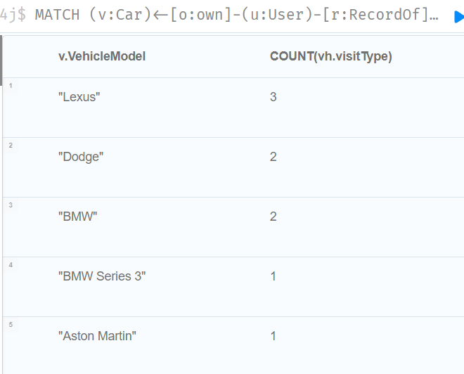
Faye
What part is the most commonly changed?
Document Model
Graphical Model

Slide 35



Overall review of all types

Slide 36
Pros and Cons for Relational database
Pros
Easy to query the report from the relationship of customer, repair job and repair detail.
High data accuracy due to defined schema
Design rules established in Conceptual and Logical diagram
The query is straightforward
Cons
It take a long process to query when it involves multiple tables.
You need to keep track all the Primary and Foreign Keys
Queries are usually is longer
Need to invole with many tables.

Slide 37
Pros and Cons for Document database
Pros
Easy to query when it not involve in too many collection.
Short query due to embedded documents and less collections
We can store the data in to the same collection. (embedded)
Cons
Hard to query when it need to aggregate multiple collections. (report)
No schema no type then easy to mistake

Slide 38
Pros and Cons for Graph database
Pros
Good to handle the relationship
Easily shows relationships from one node to another
Easier to query and follow relationships of multiple nodes
Cons
Not suitable for transactional system
Can’t handle inventory systems
No schema no type then easy to mistake

Slide 39
CRM of BMW when combine technology
Relational Database
For Online transaction processing propose.
Inventory database
Document Database
For Online transaction processing propose.
Customer, Vehicle, Repair database,
For Online analytical processing propose.
Dashboard (not adhoc)
Access log

Slide 40

CRM of BMW
If we can choose only one database
Relational Database
Document Database
Graphical Database

Slide 41
Conclusion
For our the Customer Relationship Manage

Slide 42
Thank you

